Slide 1


Research Proposal Presentation
Detecting Misinformation on Social Media Platforms:
Methods, Robustness, and Governance
Unsplash by Jorge Franganillo
Notes:
Within the next fifteen minutes, I’ll sketch out why this issue is relevant for cybersecurity, the exact research question I’ll be answering, aims and objectives, method and statistical plan, governance and ethics guardrails, and a plausible timeline.
The general concept is a hybrid detection pipeline that remains effective when topics change or when adversaries shuffle, and that opens a calibrated confidence and abstain the human escalation path so it can be responsibly deployed (Shu, Mahudeswaran and Liu, 2020; Guo et al., 2017).
You’ll notice there are three pillars that permeate the proposal:
(1) a modular architecture that integrates content, optional context, and retrieved evidence (Thorne et al., 2018);
(2) a time-split, cross-dataset, and adversarial robustness check using evaluation (Guimarães, Figueira and Torgo, 2021); and
(3) a governance mapping that ensures model outputs are explainable and auditable. (European Union, 2024).

Slide 2
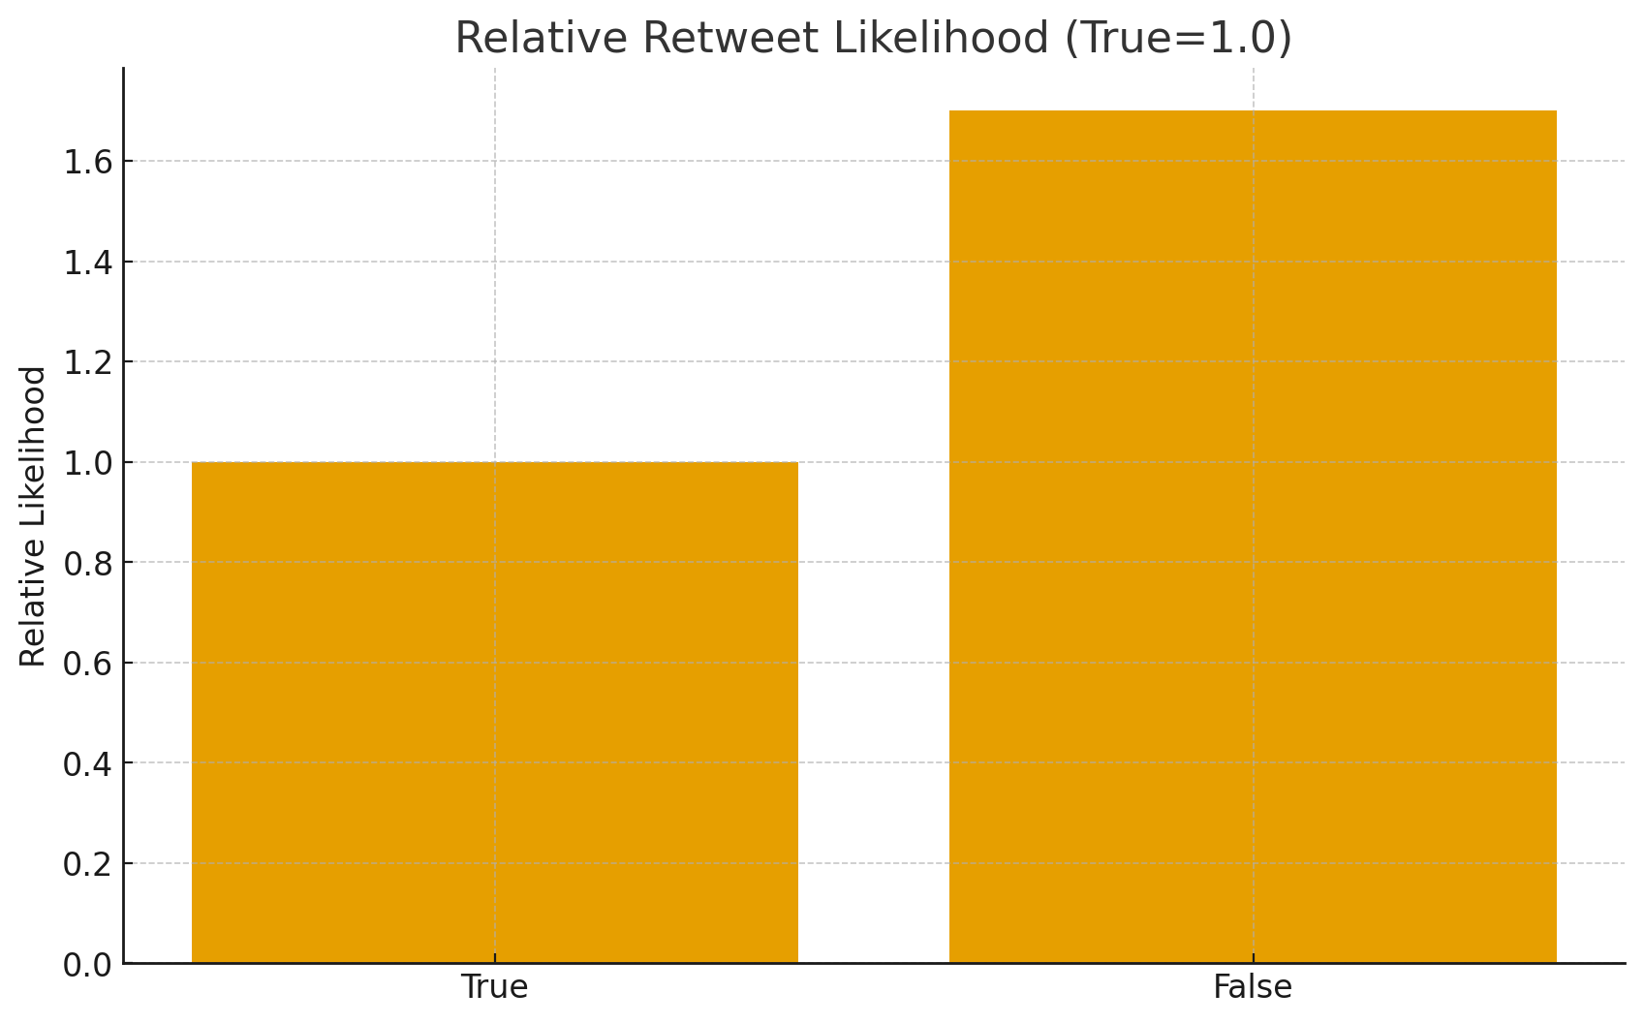
Problem & Significance
False/AI-boosted claims spread faster than manual checks
Cybersecurity risk: information integrity, manipulation
Need robust automation that survives drift & attacks
Notes:
Misinformation moves at social-media lightning speed (Vosoughi, Roy and Aral, 2018).
Empirical analysis on Twitter/X confirms false news spreads further, faster, deeper than true news, and is some 70% more likely to get retweeted, especially on political matters (Vosoughi, Roy and Aral, 2018).
That dynamic poses an information-integrity risk for society and for platforms. At the same time, generative AI makes convincingly cheap variants, driving volume and diversity upward (Chen and Shu, 2023).
Human moderation and manual fact-checking won’t be able to match this scale and pace.
The gap in practice is that detectors which appear strong on in-domain sets commonly malfunction out of the box or in the wild, when things change, when new sources emerge, or when text is paraphrased for stylistic evasion cues.
To fill that gap, there is a need for robustness of automation to drift and adversarial changes and for exposure of confidence and rationale so that systems may defer to people when the model is doubtful (Guimarães, Figueira and Torgo, 2021).
This proposal aims directly at that mix of technological soundness and sound governance.

Slide 3
Research Question
Design a detector robust to domain/time shift & adversarial inputs
Align outputs with transparency, audit, and human oversight
Notes:
My central question is:
How do we craft and assess an automated misinformation discerning framework that continues to be effective when there is domain shift or time shift and robust when faced with adversarial inputs, while incorporating transparency, auditable mechanisms, and human supervision for responsible deployment?
This breaks into two threads.
First, robustness: generalising better than a single benchmark, and formally testing time-split as well as cross-dataset performance with adversarial paraphrases (Guimarães, Figueira and Torgo, 2021).
Second, governance: enforcing the system provides explanations and logs, adjusts its confidence, and defers when doubtful so low-confidence cases go up to people (European Union, 2024).
Both threads should be happy for everyday usage.

Slide 4
Aim & Objectives
Aim: robust, governance-aware detection framework
O1: recent gaps from ACM/IEEE/LNCS/DBLP
O2: hybrid model (content + context + retrieval), calibrated + abstention
O3: time-split, cross-dataset, adversarial, CIs & paired tests
O4: governance mapping (explanations, logs, human-in-loop)
Notes:
Objective: Develop and analyse a resilient, governance-informed detection mechanism.
O1: Gap analysis. Summarise recent results on fake-news classification, rumour verification, and claim verification; compare random vs temporal splits (Guimarães, Figueira and Torgo, 2021).
O2: Hybrid approach. Adopt a modular framework merging a transformer content encoder with optional context information along with evidence retrieval for claim-like text; decisions comprise a calibrated probability and a policy-based abstention mechanism (Thorne et al., 2018; Guo et al., 2017).
O3: Robustness checking. Stress-test the model using time-split, cross-dataset, and adversarial scenarios; make interval estimates and paired tests to ensure improvements are real, not by chance (Guimarães, Figueira and Torgo, 2021).
O4: Governance mapping. Map outputs to platform needs—explanations/rationales, per-item audits with model/data versioning, and a separately documented human-in-loop policy (European Union, 2024).

Slide 5
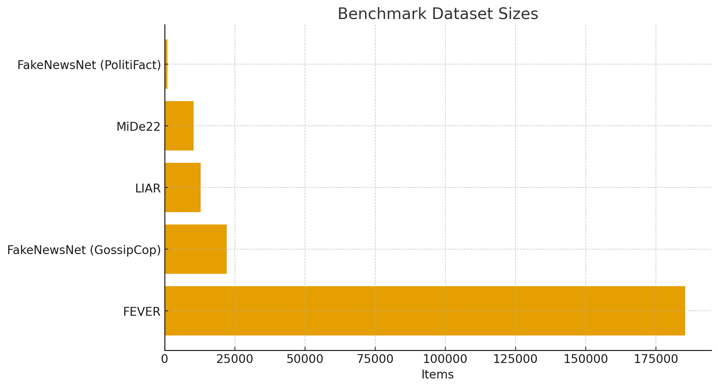
Key Literature & Datasets
Tasks: fake-news, rumor, claim verification
Data: posts/threads + news corpora: some multimodal
Limits: English/topic bias, random splits inflate scores
Notes:
Misinformation detection emerges as three task sets.
Spuriously classifying fake-news assigns labels to headlines/articles or corresponding post links.
Rumour verification datasets built from social media threads arising from claims. (true/false/unverified).
Claim verification extracts evidence, conducts text entailment, for affirming or debunking a statement (Thorne et al., 2018).
Representative datasets are
FEVER (≈185,445 claims with evidence annotations) (Thorne et al., 2018),
FakeNewsNet (GossipCop news with social annotations;
PolitiFact articles) (Shu, Mahudeswaran and Liu, 2020),
LIAR (≈12.8k short sentences with truth labels) (Wang, 2017), and
MiDe22 (≈10.3k tweets, Turkish and English) (Toraman, Taspinar and Yanikoglu, 2022).
One lingering constraint is evaluation bias: within a single dataset, random train/test splits might transmit topics or source style between splits, which inflates performance; thus this proposal favours time-attentive and out-of-dataset testing (Guimarães, Figueira and Torgo, 2021).

Slide 6
Methods Landscape
Content transformers: strong in-domain, brittle under shift
Propagation/GNNs: spread patterns, earlier flags
Hybrid + retrieval: better accuracy & explainability
Notes:
Content-based transformers like BERT style models capture semantics and style and are strong in-domain, but can overfit to source or topic, making them brittle under shift.
Propagation/GNN approaches use how information spreads, retweet/reply graphs, early burst dynamics, or lightweight source reputation signals to flag suspicious items earlier, though such signals are not always available at decision time.
Hybrid and retrieval-augmented systems combine content with context and sometimes retrieve evidence from knowledge bases; this tends to improve both accuracy and explainability (“flagged because retrieved evidence contradicts the claim”).

Slide 7
Challenges
&
Gaps
Generalisation: accuracy drops under time/topic shift; cross-dataset performance degrades (SNAM 2024).
Adversarial: paraphrases & LLM-crafted variants evade detectors (ACM 2025 BeamAttack, RATE 2025).
Calibration & UX: avoid overconfidence; enable abstention & human-in-loop.
Notes:
Three enduring gaps inform the design of evaluation.
Generalisation: when you train on the history and then predicate on future events, performance declines compared to random splits; time shift is a true deployment issue (Guimarães, Figueira and Torgo, 2021).
Adversarial manipulation: paraphrases or LLM-automated rewrites of small sizes might escape simple detectors, so naïve detectors require explicit adversarial testing and, where applicable, lightweight robust training (e.g., paraphrase augmentation) (Chen and Shu, 2023).
Calibration & UX: current neural nets are regularly overconfident; a calibrated model with an abstention threshold lowers high-stakes false positives by sending low-confidence cases for human evaluation (Guo et al., 2017).
This work thus promises time-based and out-of-dataset evaluation and calibration and selective prediction (abstain) within the decision layer of the model.

Slide 8
Methodology (Dawson)
Plan → Design → Implement → Evaluate → Report
Iterative builds; version control; risk & ethics checkpoints
Deliverables: model, eval suite, governance docs
Notes:
I’ll conduct the work with the help of a formal computing-project process: Plan → Design → Implement → Evaluate → Report.
Planning calms scope, risk, and data management.
Design specifies schemas, model decisions, and ablations.
Implementation goes on in tiny increments under version control with experiment logging for reproduction.
Evaluation is built into the very sprint, not only the end.
Parallel reporting is done, so findings do not get misplaced.
A risk log documents data availability, computational cost, and integration complexity, along with mitigations like fallback datasets, smaller models, or delayed optional context features.
Ethics review encompasses data licensing, privacy, and no-harm management of adversarial deep fakes (European Union, 2024).
Regular supervisor checkpoints at important milestones maintain scope feasible and quality high.

Slide 9
Statistical Plan (Berenson et al.)
Metrics: Acc, P/R/F1, AUROC; calibration via ECE
Repeated runs; 95% Cis, paired tests vs baselines
Report effect sizes & practical significance
Notes:
Quantitatively, I’ll report Accuracy, Precision/Recall/F1, and AUROC, plus calibration metrics—Expected Calibration Error (ECE) and reliability plots—because deployment decisions rely on trustworthy probabilities.
Each comparison (baseline vs proposed; content-only vs hybrid; calibration on/off) will use repeated runs or folds and 95% confidence intervals.
I’ll use paired tests (e.g., paired t-tests; non-parametric if assumptions fail) on per-split metrics and report effect sizes.
Crucially, I’ll emphasise practical significance: for example, a modest F1 gain that halves high-confidence false positives is an operational win because it reduces the risk of confidently wrong auto-labels. For probability reliability, I’ll apply temperature scaling, a simple post-hoc calibration method that consistently improves alignment between predicted confidence and empirical accuracy.

Slide 10
Architecture — Hybrid Detection Pipeline
Ingest
Content Encoder
(Transformer)
Context (opt.)
Evidence
Retrieval
Fusion & Scoring
Calibrated Decision
(Abstain → Human)
Notes:
The six-step proposed pipeline is explained above.
Ingest processes the article or post and standardises metadata.
Content Encoder is a misinformation-label fine-tuned transformer.
Context (optional) injects cheap features: a coarse source-reputation score, rudimentary early-engagement features, or superficial graph cues when available.
Evidence Retrieval is activated for claim-type inputs, retrieving a number of candidate sentences from high-quality sources for textual-entailment scoring (Thorne et al., 2018).
Fusion & Scoring merges cues using a tiny gating MLP.
Temperature Scaling applies learned scaling on validation, calculates a probability with a confidence band, and imposes an abstention policy below threshold, sending those items to a human queue (Guo et al., 2017).
Each decision releases a log with inputs, features utilised, evidence clips (if retrieval was on), confidence, and model/data version IDs. That trail supports compliance reviews and reproducibility (European Union, 2024).
Footnote:
(MLP) - Multi-Layer Perceptron is a simple feed-forward neural network consisting of several layers of fully connected neurons.

Slide 11
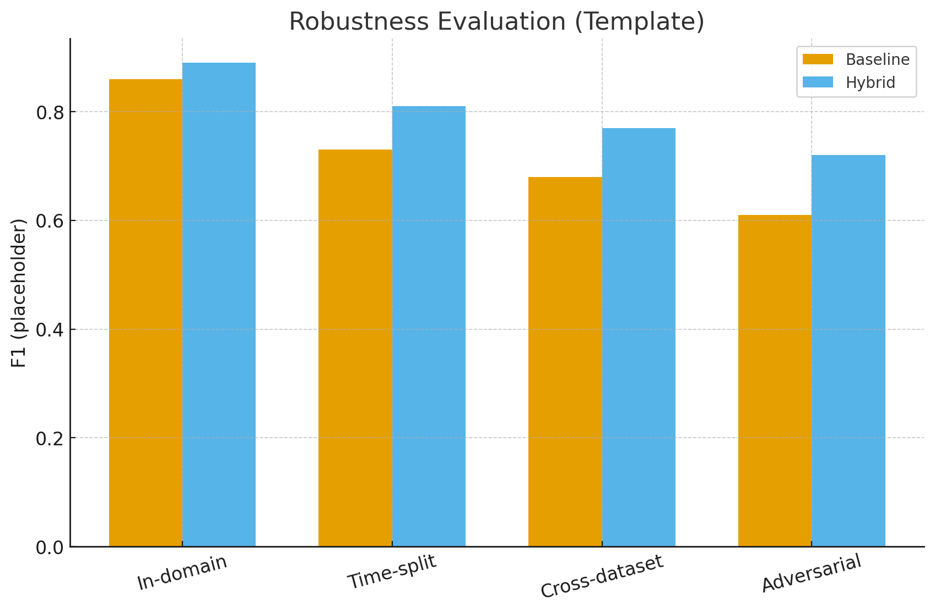
Robustness Evaluation
Time-split: train past, test future
Cross-dataset: train A, test B
Adversarial: paraphrases & LLM variants
Ablations: content vs +context vs +retrieval: calibration on/off
Notes:
I will stress-test the system in four mutually orthogonal ways.
Time-split: train on old data (T0), test on new data (T1) to measure temporal drift; report decline and assess whether hybridisation/calibration narrows it (Guimarães, Figueira and Torgo, 2021).
Cross-dataset: training on Dataset A, testing on Dataset B, which evaluates domain transfer; ablate context features when schemas are different (Guimarães, Figueira and Torgo, 2021; Zubiaga et al., 2018).
Adversarial: create paraphrases of, and LLM-generated variants for, held-out items to probe brittleness; optionally, conduct light robust training (e.g., paraphrase adding) and re-evaluate (Chen and Shu, 2023).
Ablations: contrast content-only vs +context vs +retrieval; calibration on vs off; and a selective-prediction mode that abstains on the lowest-confidence quantile (Guo et al., 2017).
Success is not only a better in-domain score, but a lesser decrease under drift and a significant increase against adversarial inputs—with calibrated likelihoods facilitating safer thresholds (Guimarães, Figueira and Torgo, 2021).
Empirical experiments also indicate LLM-created misinformation is more difficult for both humans and detectors—another reason for exposure to adversarial/LLM scenarios at test time (Chen and Shu, 2023; DeVerna et al., 2024).

Slide 12
Governance & Compliance Mapping
Requirement | Design Choice | Artefact/Proof
Transparency & Explanations | Expose evidence & confidence | Explanation examples: UI screenshots
Provenance & Audit | Per-item decision logs: model/data versioning | Audit trail: model card
Human Oversight | Abstention threshold: escalation queue | Policy note: demo UI
Security & Robustness | Adversarial testing: input sanitisation | Attack set: test report
Data Protection | Public/approved datasets: anonymise IDs | Ethics statement: data sheet
Notes:
Deployment requires at least a threshold. The proposal consists of a mapping of governance from platform requirements towards design decisions and tangible artefacts.
Transparency: unveil a brief rationale and, when retrieval is active, evidence sentences; release a model card recording meant usage, boundaries, and training data (European Union, 2024).
Provenance/Audit: timestamp decisions with model and data version IDs so auditors can repeat results; keep hashed content IDs for privacy (European Union, 2024; Ofcom, 2024).
Human Oversight: set an abstention threshold and an escalation queue with service levels; lay bare confidence for the purpose of triaging (Ofcom, 2024).
Security/Robustness: report adversarial test sets and output; incorporate rudimentary input sanitisation (e.g., for over-repetition or invisible characters) and follow OWASP LLM Top 10 mitigations (OWASP, 2025).
Data Protection: base on public or licensed datasets; anonymise user IDs; accommodate a data sheet explaining columns and redactions (European Union, 2024).
These artefacts enable compliance teams to confirm responsible functionality and allow platforms to incorporate the detector without compromise on accessibility or transparency.

Slide 13
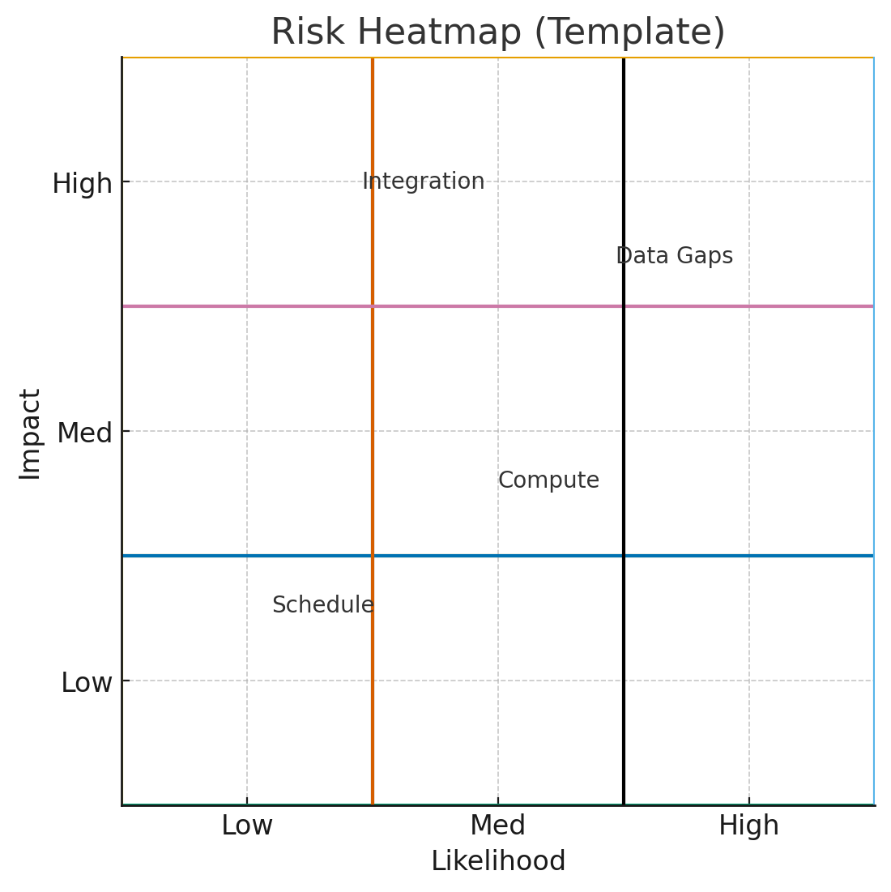
Ethics & Risk
Data licensing & privacy; no-harm handling
Bias/fairness checks; document limits
Risks: data, compute, integration, schedule → mitigations
Notes:
Ethics. Datasets will be public or duly licensed; any new collection of data follows platform terms as well as university ethics protocols.
Misinformation content won’t be projected at a greater scale; the adversarial examples synthetically created stay marked explicitly and contained.
Bias screening across topics/sources occurs for identifying disparate error rates, and I’ll detail limitations explicitly (European Union, 2024; Ofcom, 2024).
Risks & mitigations.
Data gaps: plan fallback datasets or scope adjustment.
Compute limits: favour smaller/easy-to-scale models and mixed precision; prioritise ablations with highest insight-per-hour.
Integration complexity: preserve context features optional so that the pipeline continues to operate under “content-only” mode.
Schedule: include some slack; create a solid baseline soon so evaluation continues even should advanced features fall behind.
Routine checkpoints prevent a runaway project and last-minute shocks.

Slide 14
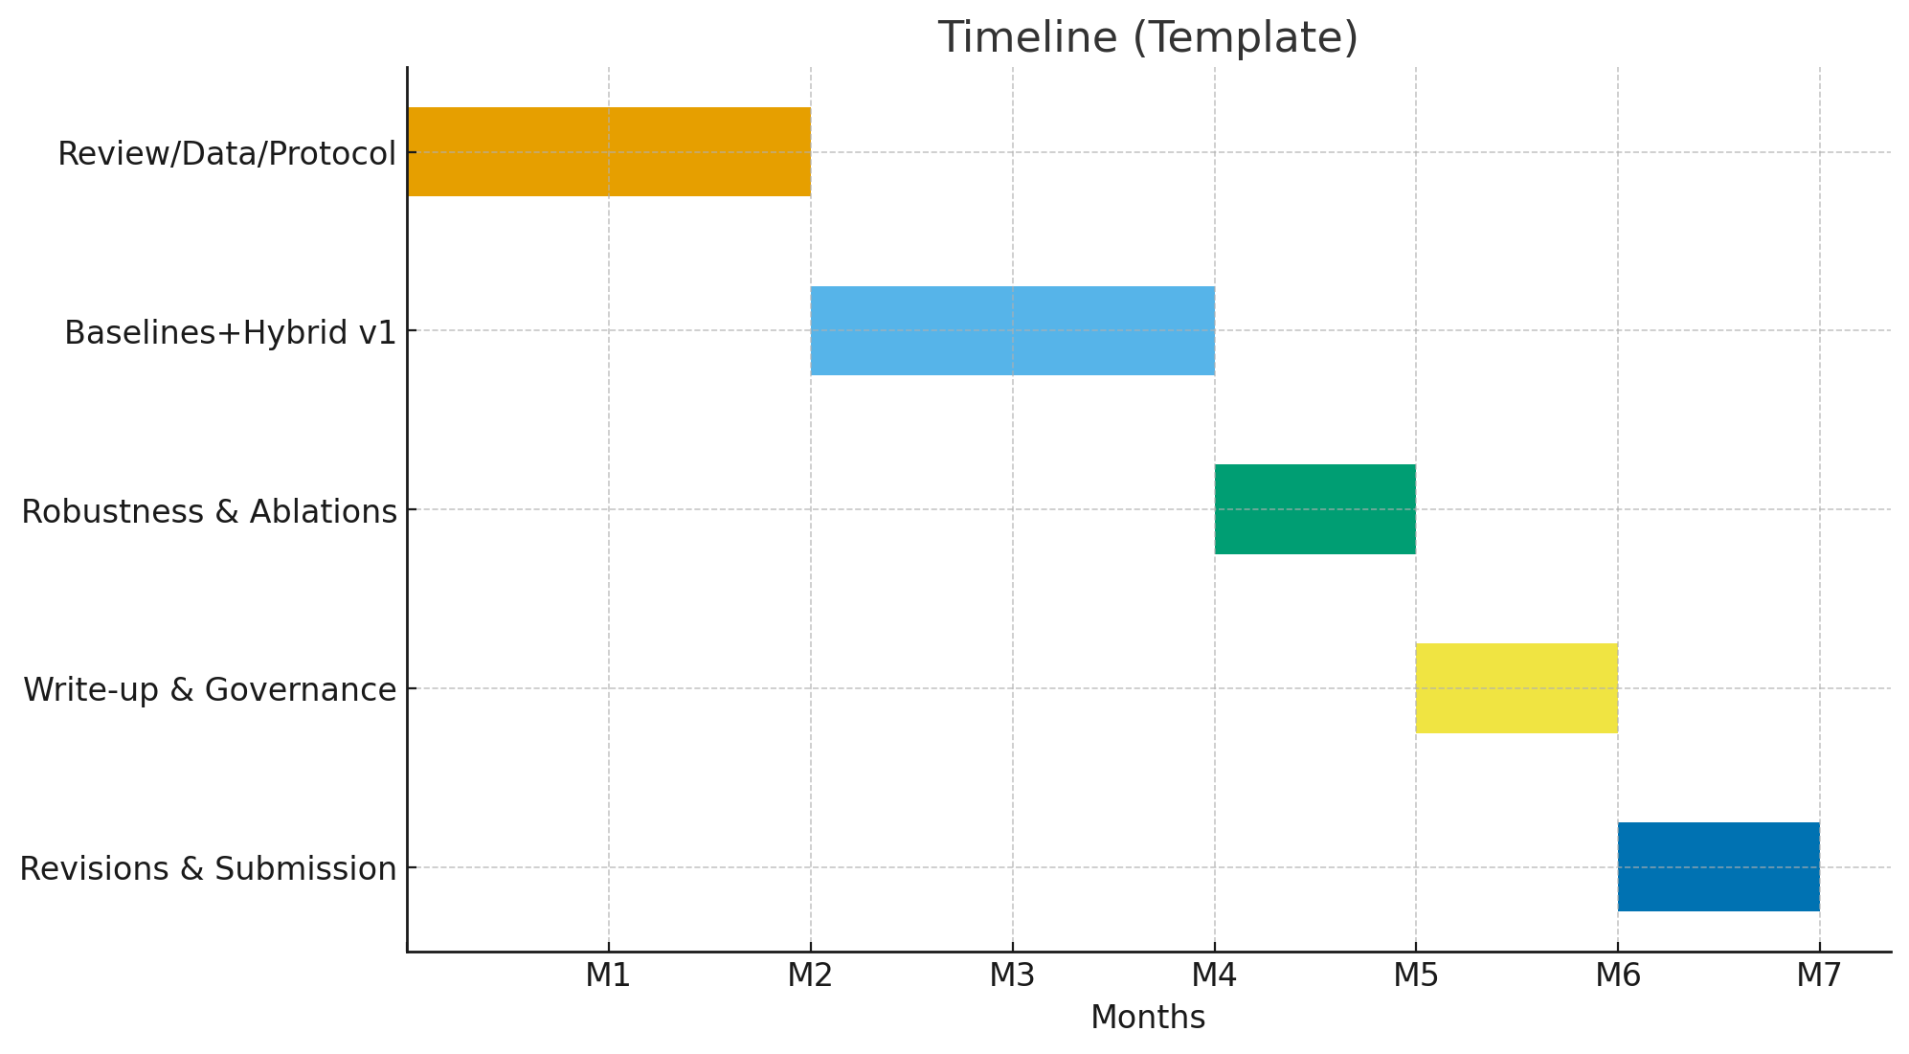
Timeline (M1–M7)
Notes:
M1–M2: complete literature review and evaluation protocol; obtain data; prepare environment; prepare ethics and data-sheet documents.
M3–M4: deploy baselines and first hybrid prototype; iterate hyper-parameters; maintain a simple validation dashboard for tracking calibration and error types.
M5: run robustness matrix—time-split, cross-dataset, adversarial—and full ablations; fit calibration; begin results chapter.
M6: prepare methodology, results, and discussion; finish governance mapping and model card; create a bare-minimum demo interface if time allows.
M7: incorporate feedback; conclude dissertation and artefacts; practise and record the final talk.
Milestones: Data in readiness (end M2); Hybrid v1 (end M4); Full evaluation set (end M5); Full draft (end M6).

Slide 15
Thank you
Notes:
In conclusion: this proposal adds a measurable resilient detection method, as well as a deployable governance stack.
The tech work zeros in on hybridisation, calibration, and selective prediction for reliability enhancement for shift and attack (Guo et al., 2017).
The governance work takes care of transparency, auditability, and human oversight so the system is practical for use (European Union, 2024; Ofcom, 2024; OWASP, 2025).
Together they transform detectors from lab-nice to field-useful. Thank you for listening.
15:58 minutes recorded audio
Uploading each slide audio file
References
Chen, C. and Shu, K. (2023) ‘Can LLM-generated misinformation be detected?’, arXiv preprint arXiv:2309.13788. Available at: https://arxiv.org/abs/2309.13788
DeVerna, M.R., Yan, H.Y., Yang, K.-C. and Menczer, F. (2024) ‘Fact-checking information from large language models can decrease headline discernment’, Proceedings of the National Academy of Sciences, 121(50), e2322823121
European Union (2024) Regulation (EU) 2024/1689 of the European Parliament and of the Council of 13 June 2024 laying down harmonised rules on artificial intelligence (Artificial Intelligence Act). Official Journal of the European Union, 12 July. Available at: http://data.europa.eu/eli/reg/2024/1689/oj
Guimarães, N., Figueira, Á. and Torgo, L. (2021) ‘Can fake news detection models maintain the performance through time? A longitudinal evaluation of Twitter publications’, Mathematics, 9(22), 2988. https://doi.org/10.3390/math9222988
Guo, C., Pleiss, G., Sun, Y. and Weinberger, K.Q. (2017) ‘On calibration of modern neural networks’, in Proceedings of the 34th International Conference on Machine Learning (ICML 2017). PMLR 70, pp. 1321–1330. Available at: https://proceedings.mlr.press/v70/guo17a.html
Lazer, D.M.J. et al. (2018) ‘The science of fake news’, Science, 359(6380), pp. 1094–1096. https://doi.org/10.1126/science.aao2998
Ofcom (2024) Ofcom’s approach to implementing the Online Safety Act: progress update. 17 October.
OWASP (2025) OWASP Top 10 for Large Language Model Applications. Available at: https://genai.owasp.org/llm-top-10/
Shu, K., Mahudeswaran, D. and Liu, H. (2020) ‘FakeNewsNet: a data repository with news content, social context and spatiotemporal information for studying fake news on social media’, Big Data, 8(3), pp. 171–188. https://doi.org/10.1089/big.2020.0062
Thorne, J., Vlachos, A., Christodoulopoulos, C. and Mittal, A. (2018) ‘FEVER: a large-scale dataset for fact extraction and verification’, in Proceedings of NAACL-HLT 2018, pp. 809–819. https://doi.org/10.18653/v1/N18-1074
Toraman, C., Taspinar, F. and Yanikoglu, B. (2022) ‘MiDe22: an annotated multi-event tweet dataset for misinformation detection’, arXiv preprint arXiv:2209.08411.
Vosoughi, S., Roy, D. and Aral, S. (2018) ‘The spread of true and false news online’, Science, 359(6380), pp. 1146–1151. https://doi.org/10.1126/science.aap9559
Wang, W.Y. (2017) ‘“Liar, Liar Pants on Fire”: a new benchmark dataset for fake news detection’, in Proceedings of the 55th Annual Meeting of the Association for Computational Linguistics (Volume 2: Short Papers), pp. 422–426. https://doi.org/10.18653/v1/P17-2067

